Slide 1

Veasualizer
Batch 23:
P Yuvaraj (18N31A05H2)
M Lakshman (18N31A05D1)
SK Anwar (17N31A05L4)
Under the guidance of
Mrs. P Honey Diana

Slide 2
Abstract
Veasualizer is a modern data visualization and a “ML” tool.
Using Veasualizer a user with zero knowledge can make beautiful visualizations: Graphs and plots. Not just that, Veasualizer has features using which users can Train, Test and Draw predictions from data by just uploading their dataset to Veasualizer.
After uploading dataset, User will have freedom to choose different algorithms suitable for their data and can even choose different parameters for training the dataset on which accuracy of the model depends on.
At the end user will get an Exploratory Data Analysis Report (EDA) for their dataset.
Objective next

Slide 3
Objective
The whole idea of this project is based on its user base, that is people who are going to use it.
Our main objective of Veasualize is to make stuff, which is complex, look easy and useful to everybody.
Just by some clicks and uploading datasets, Users will be able to plot different plots like: Scatter plot, Bar graphs, Bubble plots, Box plots, Dot plots, Pie charts and more and ML algorithms include Regression and Classification algorithms like: Linear, Polynomial, Logistic etc
Literature survey next

Slide 4
Literature Survey
We tried to find a project or tool similar to our project but, There are popular tools like Power BI, Tableau, Which can only visualize user’s dataset that too, These tools comprosses a lot of complex features and make simple task of data visualization tough.
And there are no tools which can take pre-processed data as input from user and use ML algorithms to forecast or draw predictions from it (Train - Test - Predict).
Veasualizer, Our proposed system is a simple tool which has all the problems explained above, full filled.
Proposed system next

Slide 5
Proposed System
Veasualizer, Our proposed system is a simple, user friendly and powerful tool.
Veasualizer is a software that can generate plots and graphs from the dataset uploaded by user, and these can be downloaded in jpg or png format. Apart from visualizing user’s dataset, Here using this tool users can also draw predictions.
In our project (proposed system), we are implementing:
Bar Graph, Histogram, Scatterplot, Area plot, Pie plot and more
ML algorithms include,
Regression: Linear, Logistic and Polynomial
Classification: Decision Tree, Random Forest and SVM
Requirements next

Slide 6
Requirements
Software Requirements
The development and deployment of the application requires the following general and specific minimum requirements for software:
1. Programming Language Translators - Python 3.7 and above.
2. IDE – Spyder or Visual studio code.
3. Operating System used Windows 7 or above.
Hardware Requirements
The development and deployment of the application requires the following general and specific minimum requirements for hardware:
1. Processor- (32-bit or 64-bit)
2. RAM (4 GB or above)
3. Hard disk: 450MB
UML

Slide 7
UML
●UML stands for Unified Modeling Language. UML is a standardized general-purpose modeling language in the field of object-oriented software engineering. The standard is managed, and was created by, the Object Management Group.
●The goal is for UML to become a common language for creating models of object oriented computer software.
●In its current form UML comprised of two major components : a Meta-model and a notation.
●The UML is a very important part of developing objects oriented software and the software development process. The UML uses mostly graphical notations to express the design of software projects.
Types of UML:
Use case diagram
Class diagram
State diagram
Collaboration Diagram
Activity Diagram

Slide 8
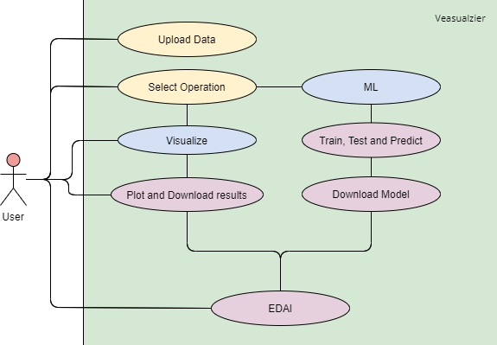
Use Case Diagram
A use case diagram in the Unified Modeling Language (UML) is a type of behavioral diagram defined by and created from a Use-case analysis.
Its purpose is to present a graphical overview of the functionality provided by a system in terms of actors, their goals (represented as use cases), and any dependencies between those use cases.

Slide 9
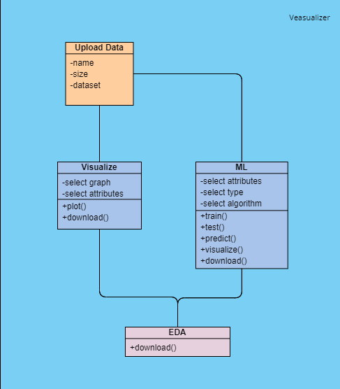
Class Diagram
The class diagram is used to refine the use case diagram and define a detailed design of the system.
The class diagram classifies the actors defined in the use case diagram into a set of interrelated classes.
The relationship or association between the classes can be either an "is-a" or "has-a" relationship.
Each class in the class diagram may be capable of providing certain functionalities.

Slide 10
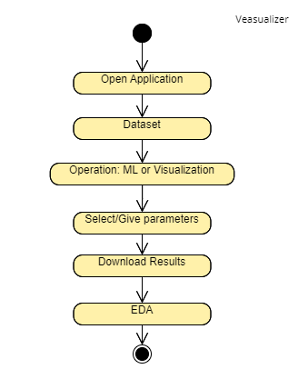
State Diagram
A state diagram, as the name suggests, represents the different states that objects in the system undergo during their life cycle.
Objects in the system change states in response to events.
In addition to this, a state diagram also captures the transition of the object's state from an initial state to a final state in response to events affecting the system.

Slide 11
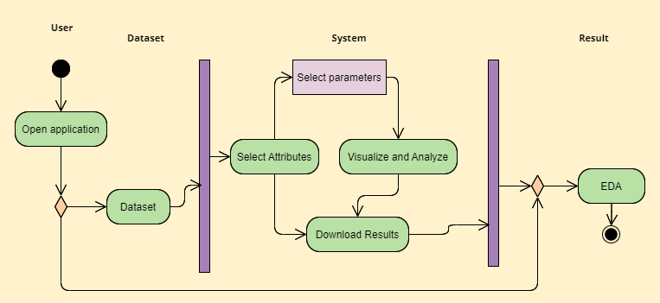
Activity Diagram
The process flows in the system are captured in the activity diagram. Similar to a state diagram, an activity diagram also consists of activities, actions, transitions, initial and final states, and guard conditions

Slide 12
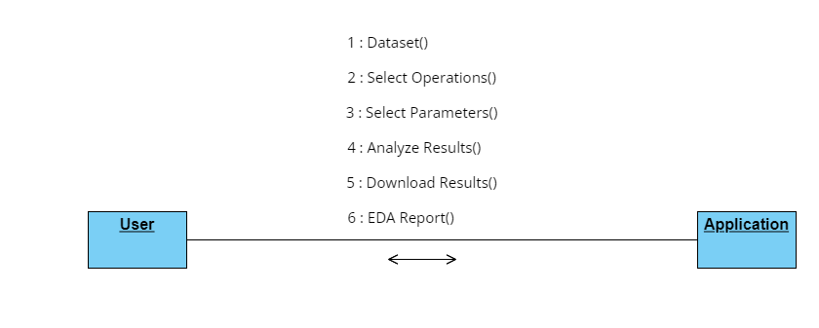
Collaboration Diagram
A collaboration diagram groups together the interactions between different objects. The interactions are listed as numbered interactions that help to trace the sequence of the interactions. The collaboration diagram helps to identify all the possible interactions that each object has with other objects.

Slide 13



Implementation
We chose the base technology as “Python”, but in Python we have many frameworks/technologies which can be used for this project’s implementation. We had 3 options to choose from:
Flask 2. Django 3. Streamlit
All these 3 frameworks are used to build web apps but their use-case is completely different though. There are some advantages and disadvantages for each of this framework.

Slide 14
Flask Vs Django Vs Streamlit
Flask provides support for API while Django doesn’t have any support for API.
Streamlit turns data scripts into shareable web apps in minutes. All in pure Python. No front‑end experience required.
Use Streamlit if you want a structured data dashboard with many of the components you’ll need already included. Use Streamlit if you want to build a data dashboard with common components.
Use Flask if you want to build a highly customized solution from the ground up and you have the engineering capacity.
Use Django if your project requirements are static and most important thing for you is time complexity and when you need a production ready-framework.

Slide 15
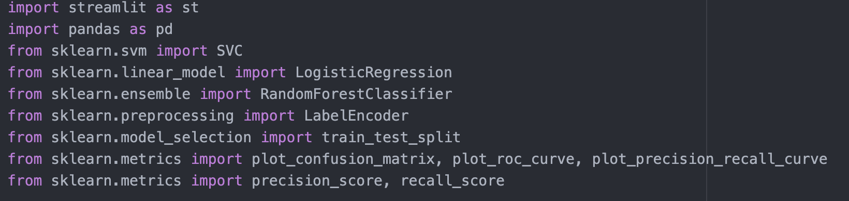
Sample Coding:
Modules/ Packages imported:

Slide 16
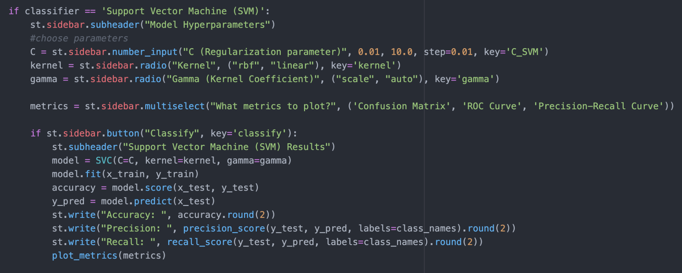
Choose Classifier:

Slide 17
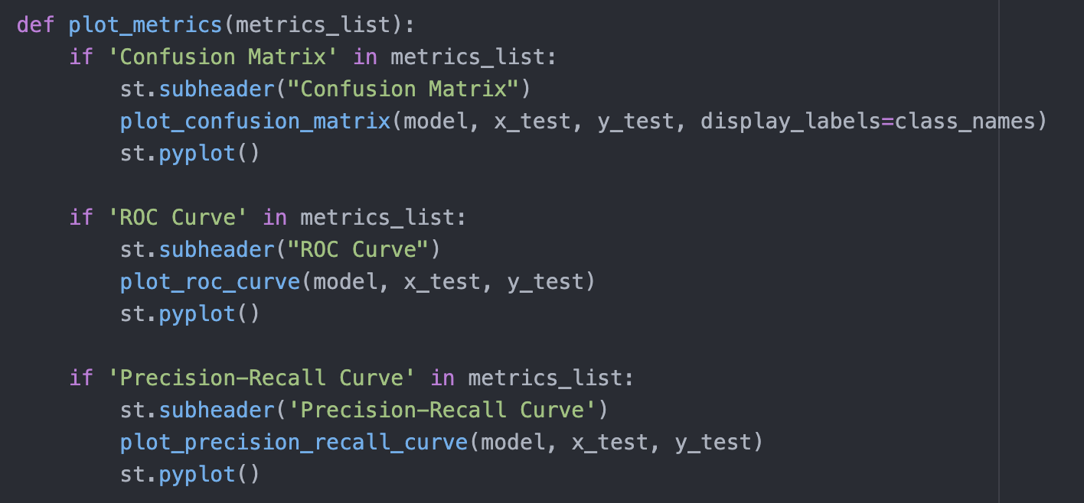
Choosing metrics:

Slide 18
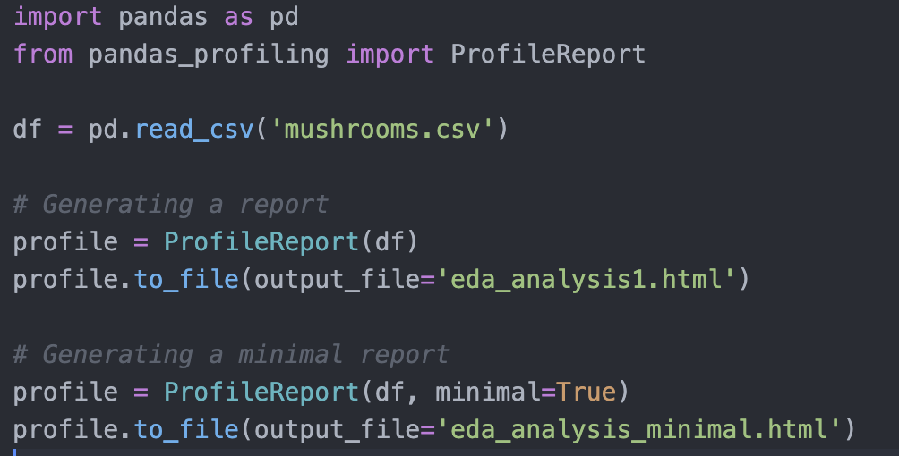
EDA Report Generation:

Slide 19
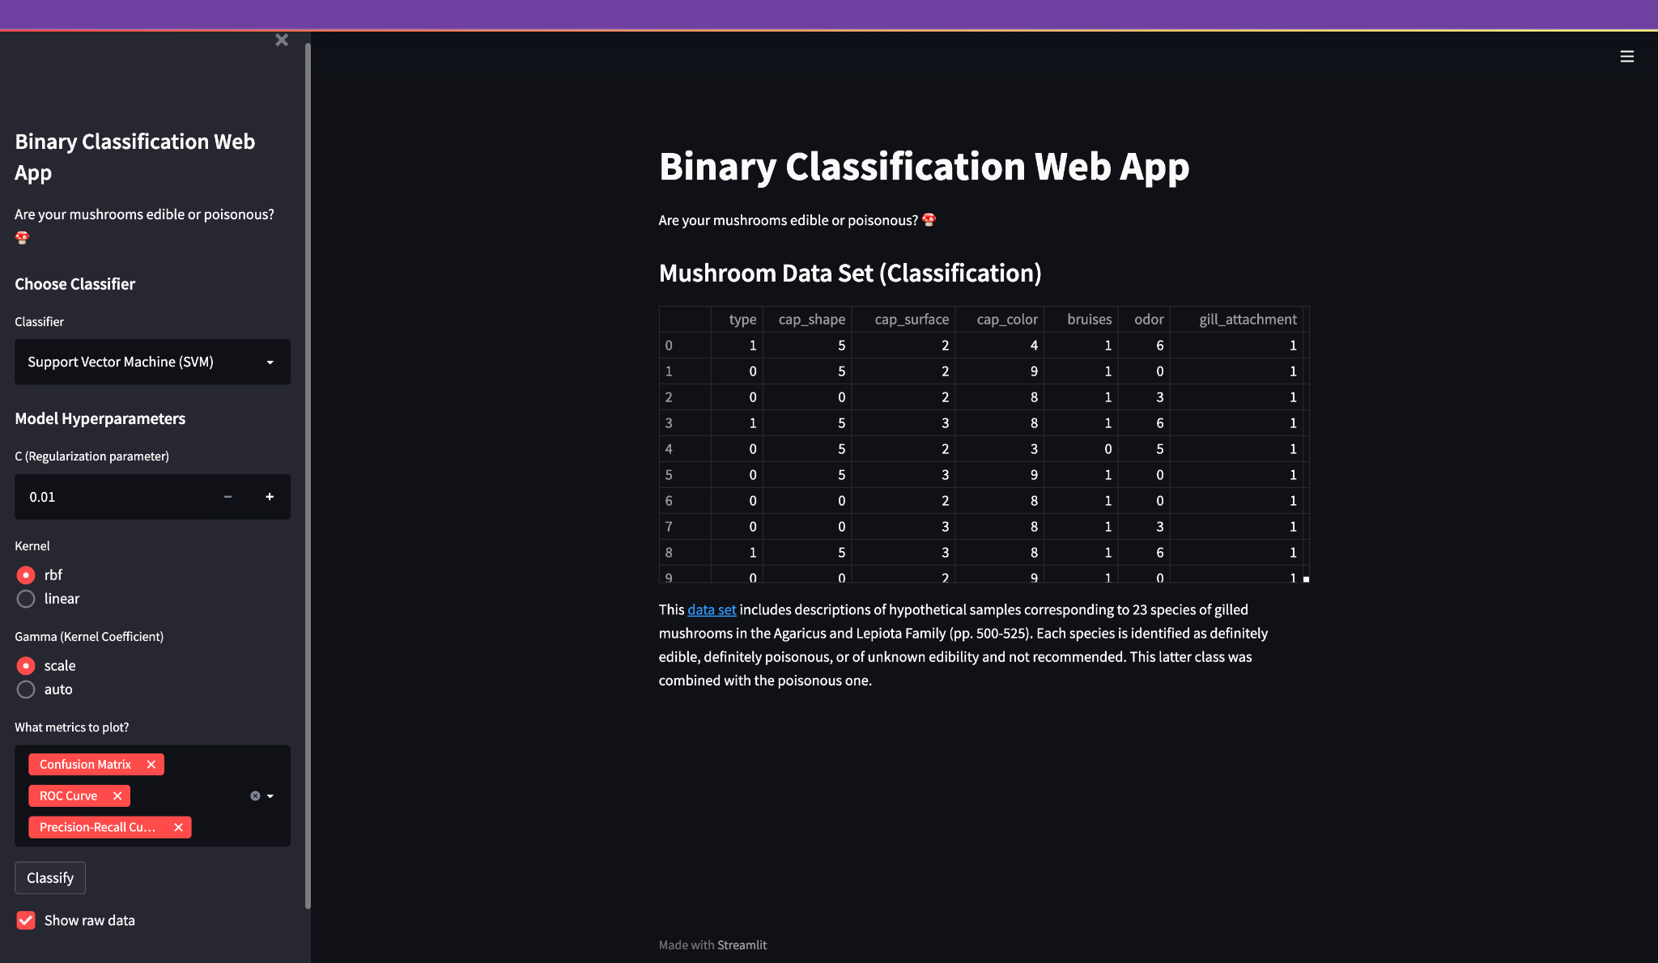
Output Screens:

Slide 20
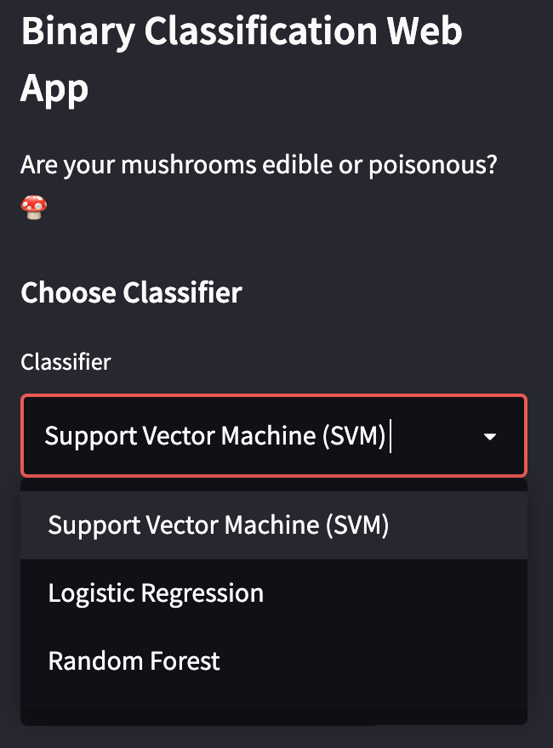
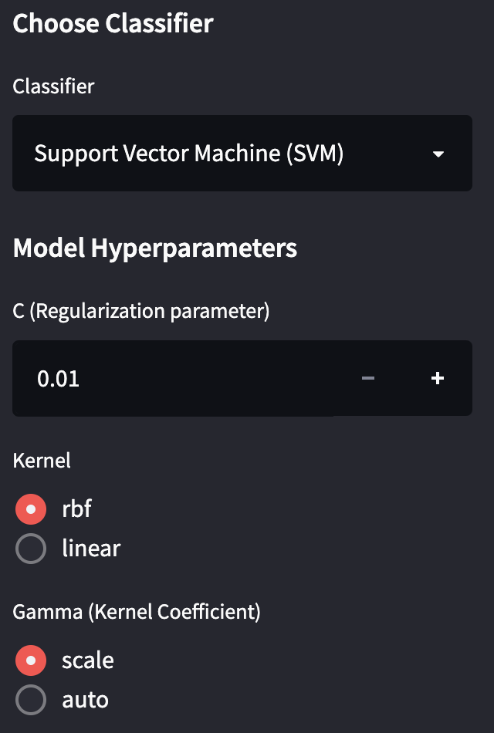
Choose Algorithm:
If SVM:

Slide 21
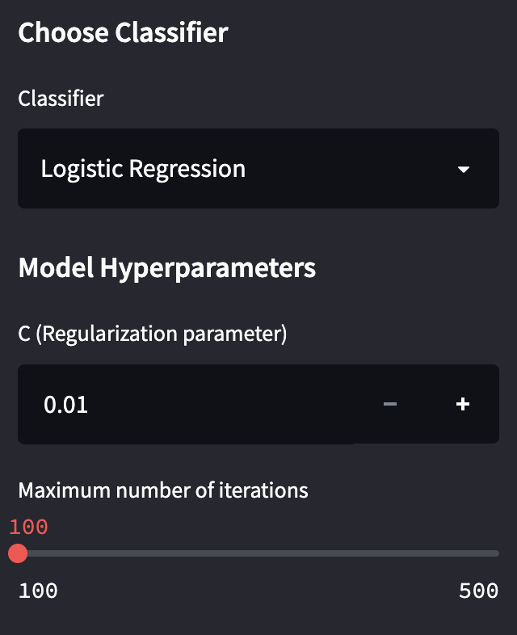
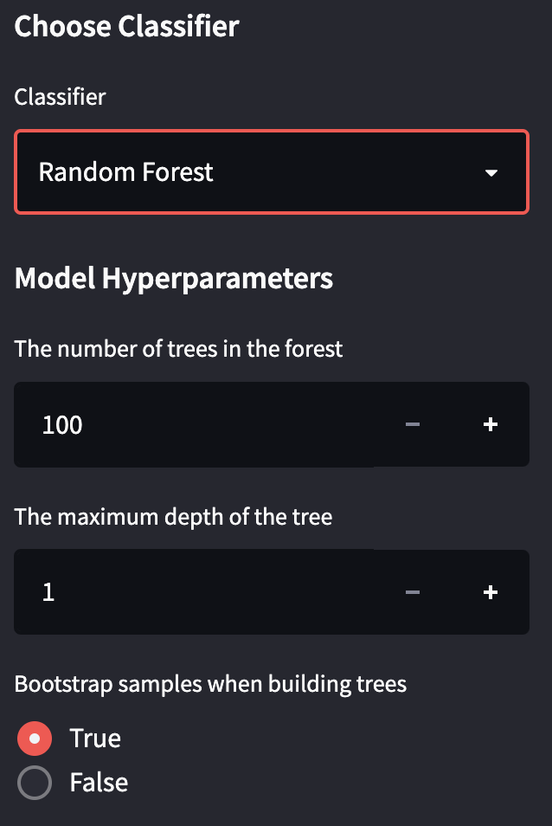
If Logistic Regression:
If Random Forest:

Slide 22
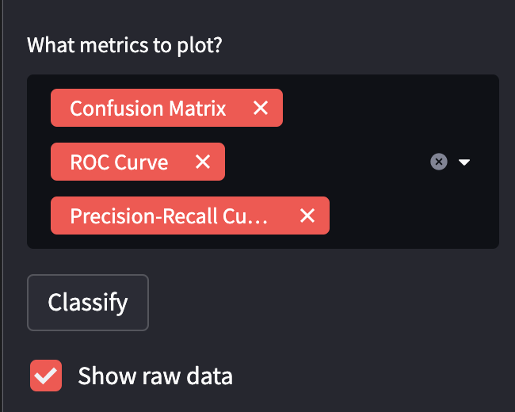
Choose metrics to plot:

Slide 23
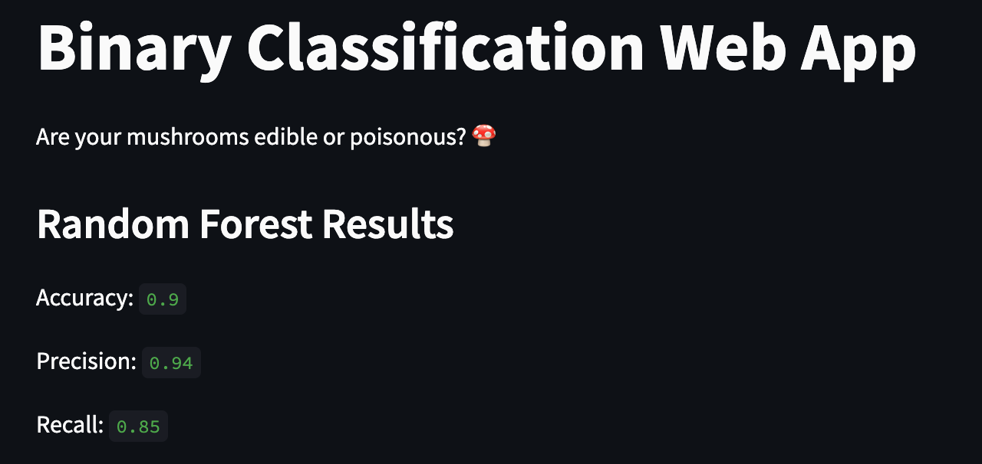
Result screens:
Download Model

Slide 24
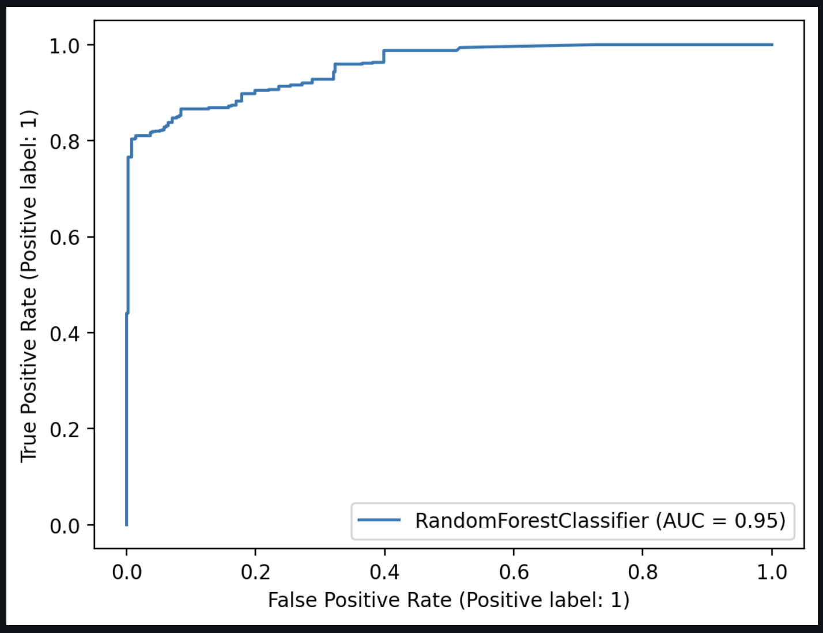
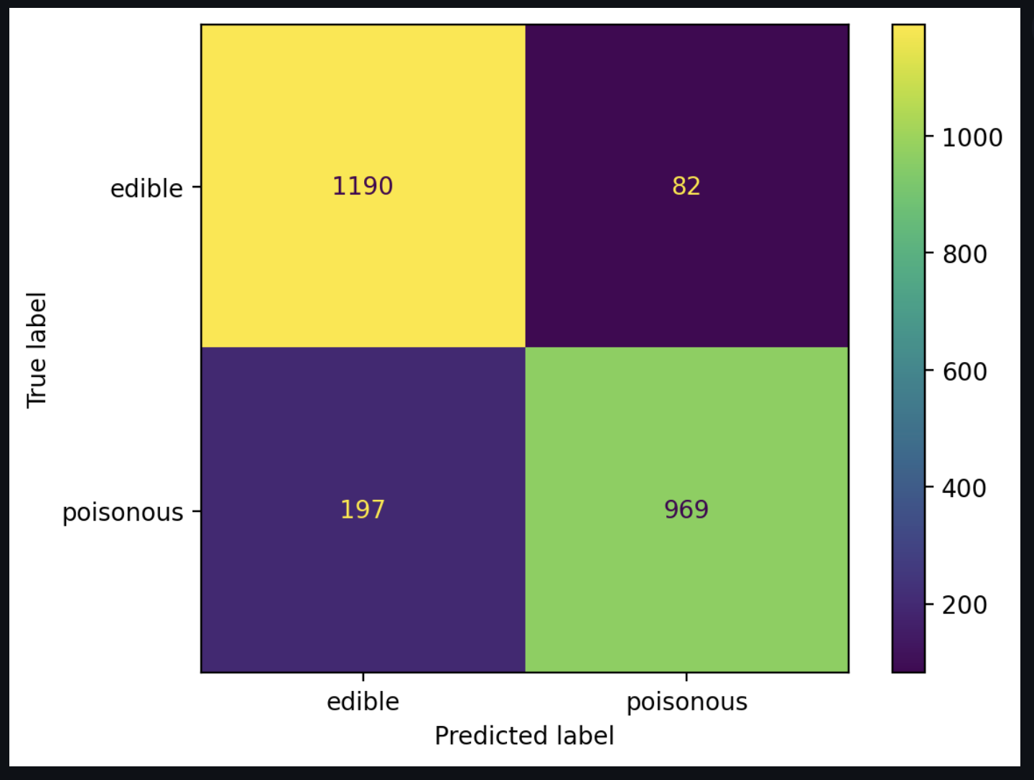
Confusion Matrix:
ROC Curve:

Slide 25
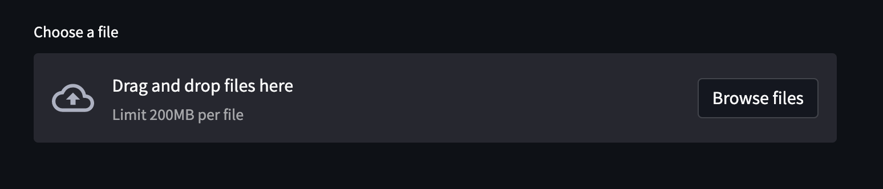
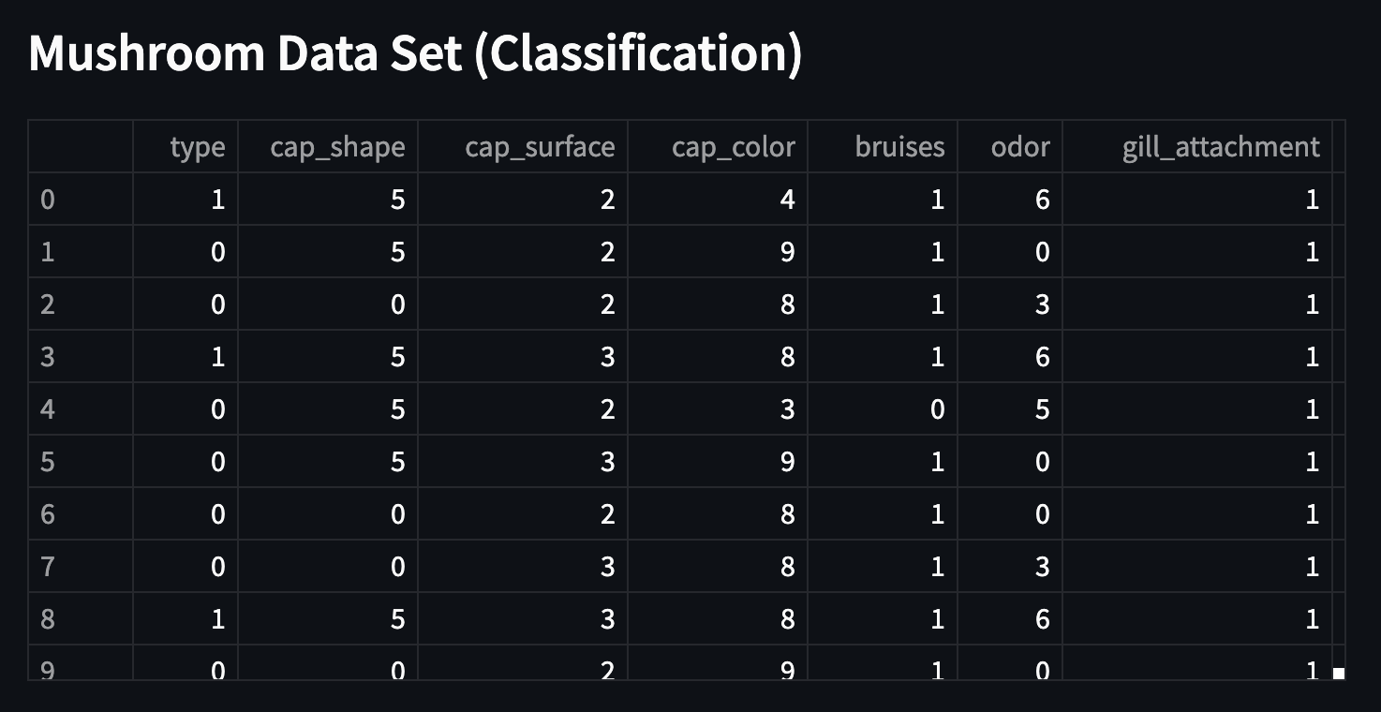
Exploratory Data Analysis (EDA) Report:
Upload Dataset:
Show Dataset:

Slide 26
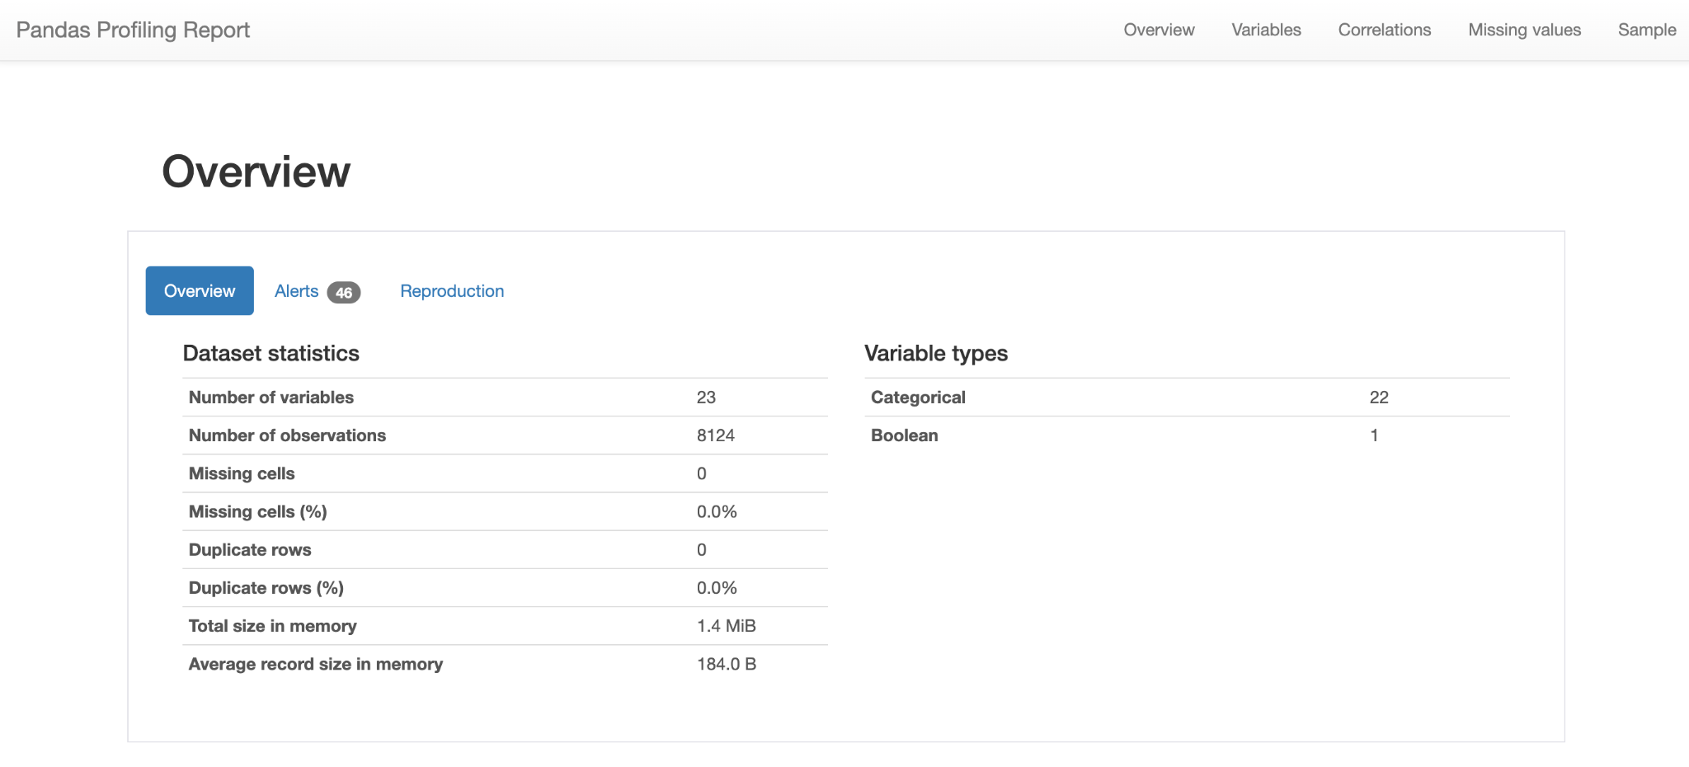

Slide 27
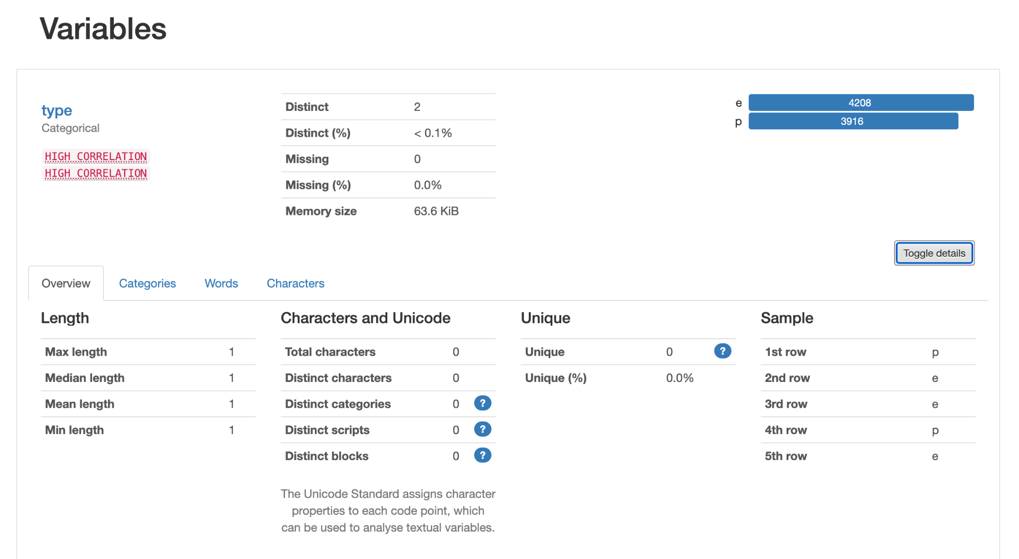

Slide 28
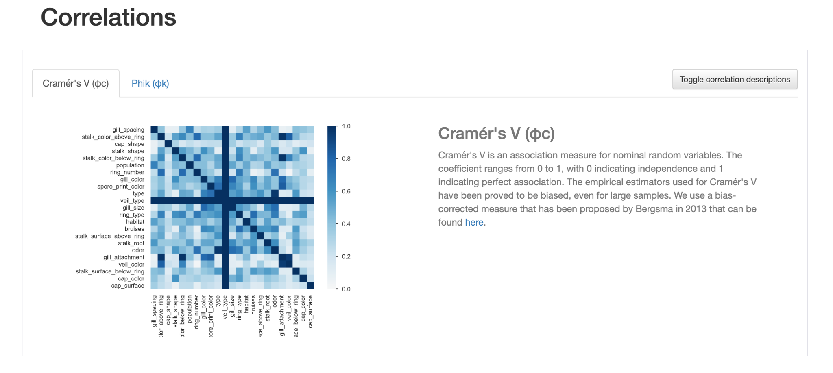

Slide 29
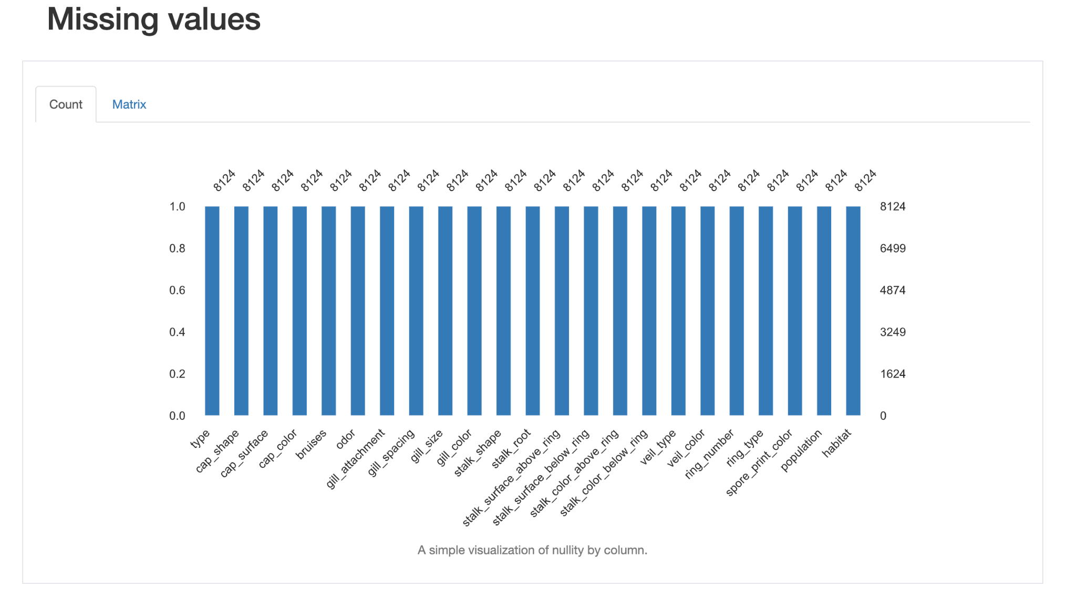

Slide 30
Conclusion:
Veasualizer is a data visualization and ML tool and Using Veasualizer a user with zero knowledge can make beautiful visualizations: Graphs and plots. Not just that, Veasualizer has features using which users can Train, Test and Draw predictions from data by just uploading their dataset to Veasualizer.
The whole idea of this project is based on its user base, that is people who are going to use it. Our main objective of Veasualize is to make stuff, which is complex, look easy and useful to everybody. Just by some clicks and uploading datasets, Users will be able to plot different plots like: Scatter plot, Bar graphs, Bubble plots, Box plots, Dot plots, Pie charts and more and ML algorithms include Regression and Classification algorithms like: Linear, Polynomial, Logistic etc
The Exploratory Data Analysis report (EDA) is what makes this project unique, EDA includes Overview of the dataset uploaded, Correlation between variables, Missing values in the dataset and Statistical description of each variable.

Slide 31
Thank you

